Slide 1

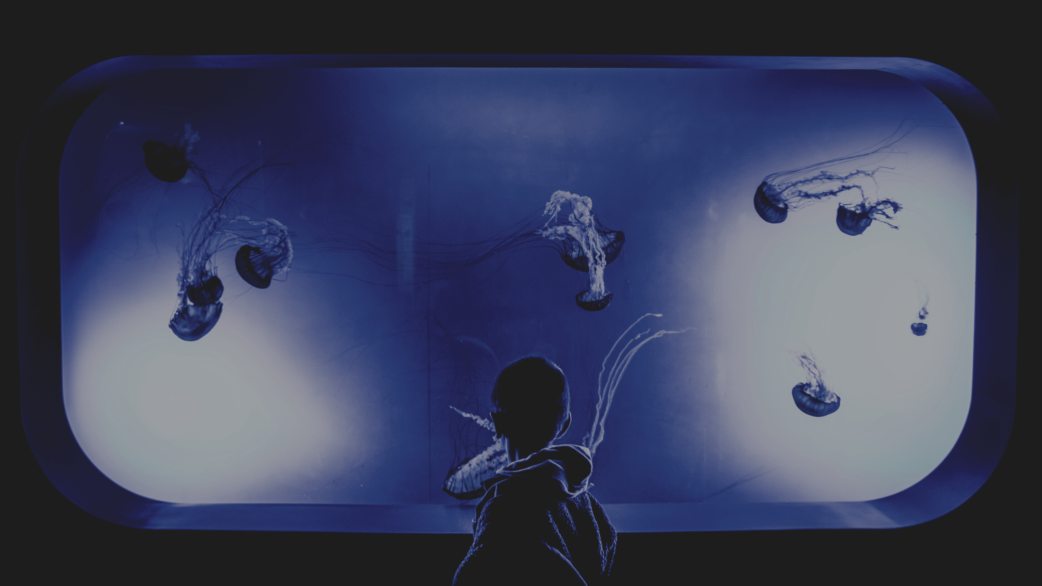

IOT Based Smart Aquarium
by GROUP 8
Group Members :-
Aryan Kumar - 190185
Naveen Kumar Mathur - 190535
Amit Kumar Singh - 190117
Prince Kumar Ahirwar - 190646
Aman Raw - 190108

Slide 2
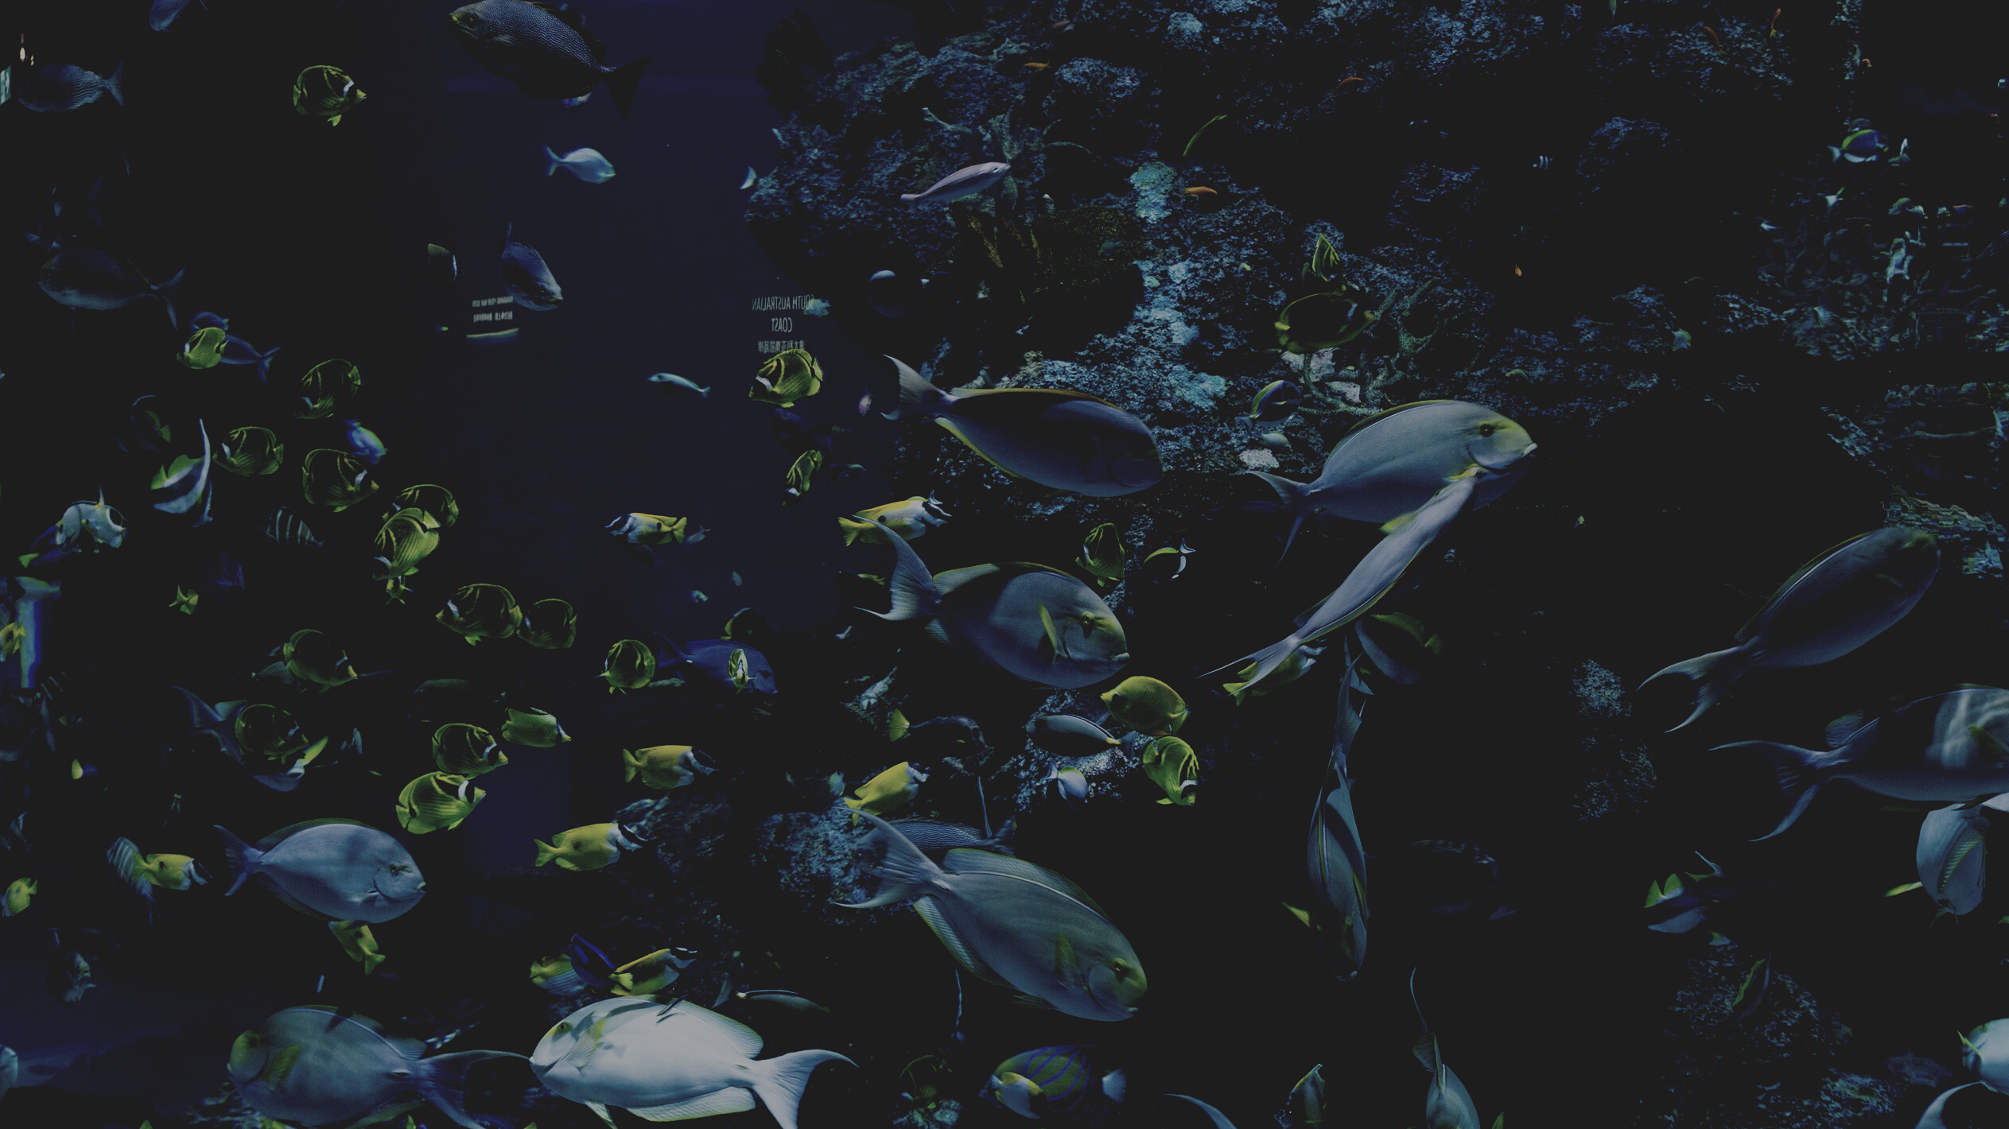


Problem Statement
- Many people keep fish as pets as it can provide decoration for a home and watching them can help people relax.
- Poor water and surrounding quality can be harmful for the fish, hence water needs to be periodically changed. It is not generally possible to know whether their aquarium is experiencing an abnormal situation.
Problem Statement: To build a simple and productive technique to examine water quality with ease, low control and user friendly and make the water quatity status available effortlessly to the client.

Slide 3

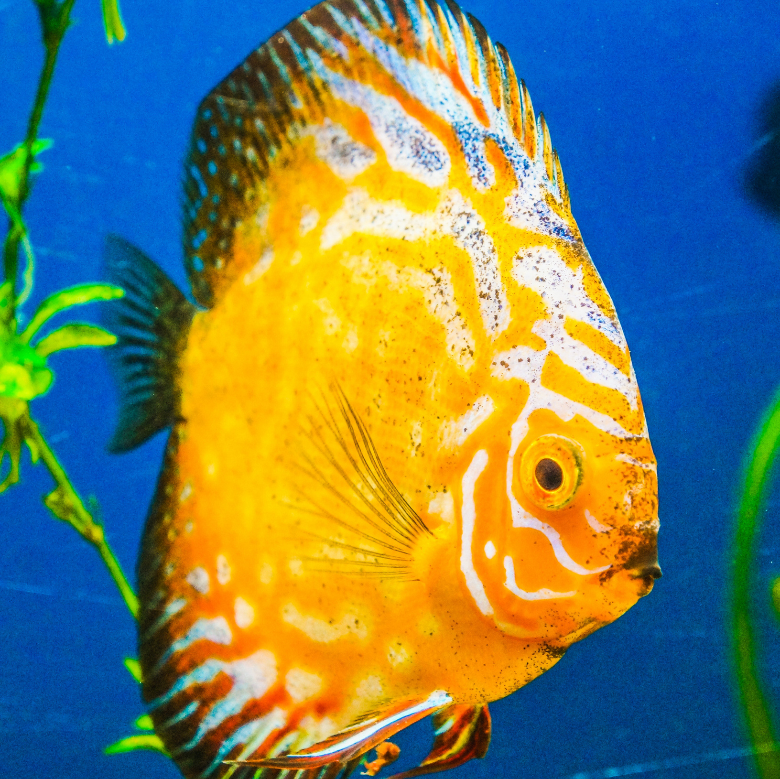
Introduction
IOT Based Smart Aquarium :
Through this project, we will monitor water quality and environment of an aquarium.
pH level and temperature measurements will help us control the water quality. Whereas, the brightness readings (crucial for fish's health) will help us in timely lumination of the tank.
We will also try incorporating some extended features in the project as well.

Slide 4
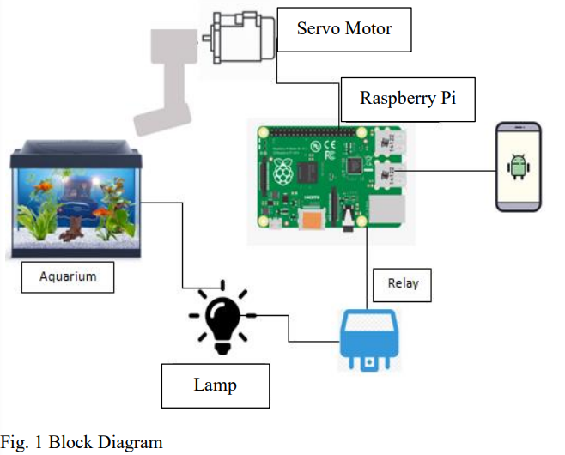

1
Literature Review
Here, smart aquarium device was designed to feed aquaculture fish automatically, namely Smart Aquarium Design Using Android-Based Raspberry Pi.
It uses a servo motor to drive the fish feeding valve and also uses a relay as an on / off aquarium decorative light. Here, Android will be the interface between the aquarium and the tools.
https://pdfs.semanticscholar.org/e054/da0e2ccc399d2b652ac6f69c6fec7d788693.pdf
Android sends data to the database later and the rasberry pi will read the data in the database. We will not be using any android interface in our project. Instead, we will be using socket programming which will be (probably) more convinient to us.
For now, we are considering the servo motor based fish feeding system as an extended functionality due to its complexity and time constraint.
The goal of creating the Raspberry Pi was to make an inexpensive device that would improve programming skills and hardware understanding.
Through this paper, we also learnt about function of relay and its connections with the Raspberry Pi board.

Slide 5
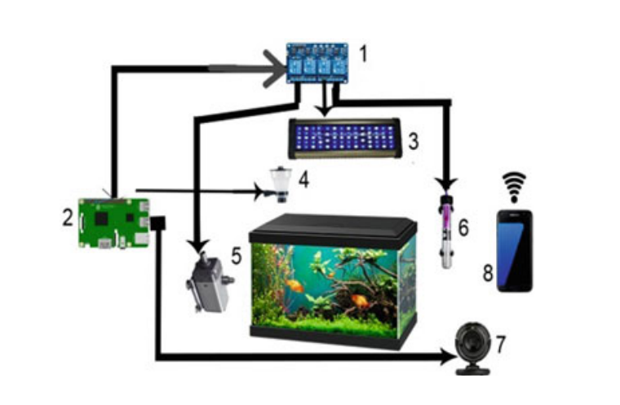
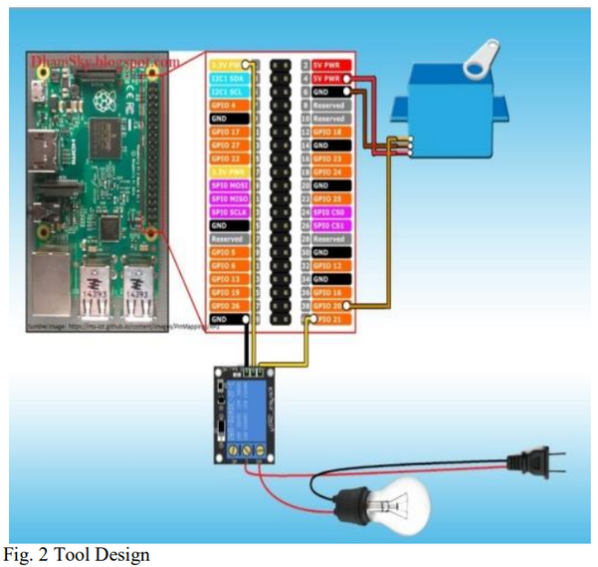
2
Literature Review
Here, the proposed technology uses Raspberry pi Webcam server to capture live video stream of aquarium, feed fishes through servomotor using pulse-width modulation, relays are used to ON/OFF light, temperature control, filter control, and android app to allow the user to access various functionalities.
We will not incomporate the webcam, filter control features because they are already been implemented and we won't add anything new and significant to the existing project.
https://www.researchgate.net/publication/340254865_Smart_Live_Monitoring_of_Aquarium-An_IoT_Application
We will rather use sensors to determine pH level in the water and maintain right pH level. Brightness in the aquarium will be synchronized with sunrise and sunset. These features are new and significant.

Slide 6
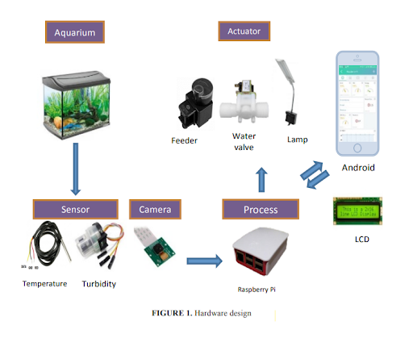
3
Literature Review
The optimal freshwater temperature range for fish survival is 25-32 degrees Celsius. The temperature affects the digestive process and metabolism of the fish.
The maximum turbidity that is safe for fish is 128 NTU. If the turbidity level of water is more than the maximum value, it is necessary to drain the pond.
https://www.researchgate.net/publication/332612763_The_smart_monitoring_and_automation_control_system_for_fish_aquarium_based_on_internet_of_things_technology
We are currently not working on controlling the turbidity, but this can be incoorporated in the extended version. This due to added complexity factor.
The system uses Cayenne for designing software system. Cayenne is third-party software-based Android to provide application system. The software provides a graph of real-time water temperature measurement.
Fill-and-Drain Water System Testing: One of solenoid valve works to drains half of height of aquarium water. After that, other water solenoid valve will open to give access the clean water to refill the aquarium water. Can use this in the extended feautures, for now this will add complexities to the project.
For the sake of simplicity, we will get the data displayed on the laptop rather than on smartphone. This is because, for now we are not planning to make any android app to display output data and control our IOT system.

Slide 7
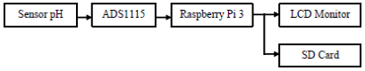
4
Literature Review
ADS1115 functions as an analog to digital converter (ADC), this component is used to change analog signal to digital, so it can be processed by the processor.
Raspberry Pi functions as a processor, which in this device functions to process the signal processing from ADS1115. Raspberry Pi also functions as a GUI so that the pH reading can be displayed on LCD monitor.
https://www.ijitee.org/wp-content/uploads/papers/v9i1/L37201081219.pdf
We will be using similar functionality in our project to sense pH of water in the aquarium.

Slide 8
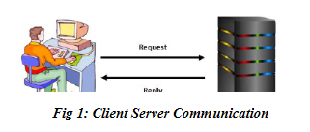
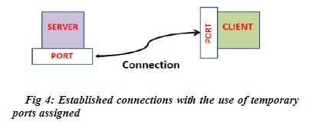
5
Literature Review
The main idea to use socket programming is because it is efficient way of communication for a client server based platform where we just need to export data as requested by the client.
basically our raspberry pi will act as a server and will provide the
data collected by the sensors and then we will establish connection that will use UDP and TCP as communication protocol between Raspberry pi and our pc over a local port and ip and after using the server's bind() method which binds it to a specific IP and port so that it can listen to incoming requests on that IP and port will exchange the data and continue further analysis.
https://www.researchgate.net/publication/322221902_Design_and_Implementation_of_Client-Server_Based_Application_Using_Socket_Programming_in_a_Distributed_Computing_Environment
[Changes] : Implementing protocol in python using socket library
Socket programming : A socket is a communications connection point (endpoint) that you can name and address in a network. Socket programming shows how to use socket APIs to establish communication links between remote and local processes.

Slide 9
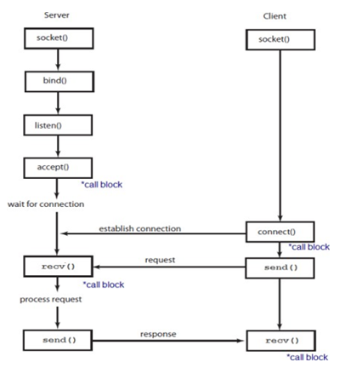
6
Literature Review
Extending the idea of using gui with a web page/application.
https://www.ijraset.com/research-paper/realtime-chat-application-using-client-server-architecture

Slide 10
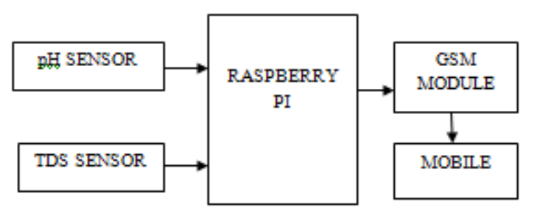
7
Literature Review
The pH and TDS level in Aquarium is monitored and collected from corresponding sensors. pH sensor measures the activity of hydrogen ion in a solution where as TDS measures the concentration of Total Dissolved solids in parts per million (ppm).
https://www.ijert.org/research/smart-home-automation-for-monitoring-ph-and-tds-level-in-aquarium-purifier-IJERTCONV6IS04087.pdf
Collected data is transfered to Rasberry pi. It is programmed in such a way that if pH and TDS levels are ideal the algorithm will stop.
If it exceeds or fall below the ideal level, it sends an SMS alert to the user mobile phone by using GSM Module.
GSM (Global System for Mobile Communication) is a digital cellular technology used for transmitting mobile voice and data services. It uses Time Division Multiple Access (TDMA) transmission method. It supports data transfer speed of 9.6 Kbps allowing transmission of SMS.

Slide 11
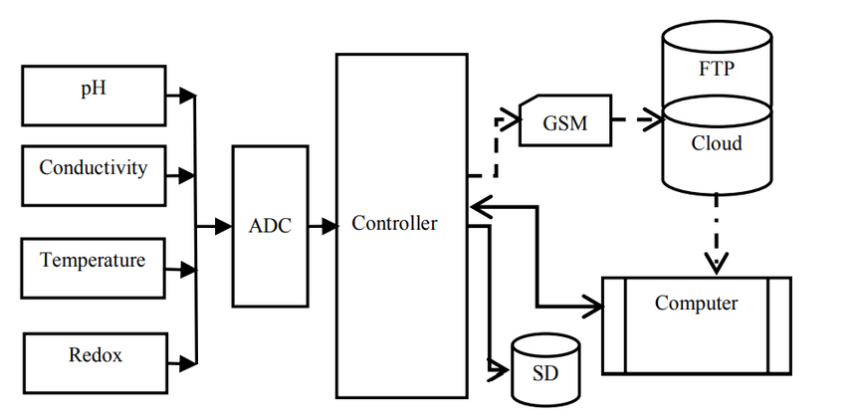
8
Literature Review
The approach in the paper considers that the parameters pH, oxidation-reduction potential (ORP), conductivity and temperature independently provides very little information in terms of how polluted the water is.
Hence, collective parameter is analyzed to generate a valid input, which is either polluted or not polluted.
https://ieeexplore.ieee.org/stamp/stamp.jsp?tp=&arnumber=7476234
The system comprises of sensors, an analogue to digital convertor (ADC), a microcontroller, an SD storage and a GSM module.
Experiment is performed on different water sources like tap water, sea water, surface water and polluted water.
The parameter references obtained from all the different water sources will be used to build classifiers which will be used to perform automated water analysis in the form of Neural Network Analysis.
In our project we will only focus on monitoring pH and temperature levels because, monitoring oxidation-reduction potential (ORP) and conductivity is not very necessary for water health monitoring in an aquarium. Even if we go for implementing these monitoring parameters for high precision readings from water, our solution would not be very cost efficient and will take a lot of time to build it.

Slide 12
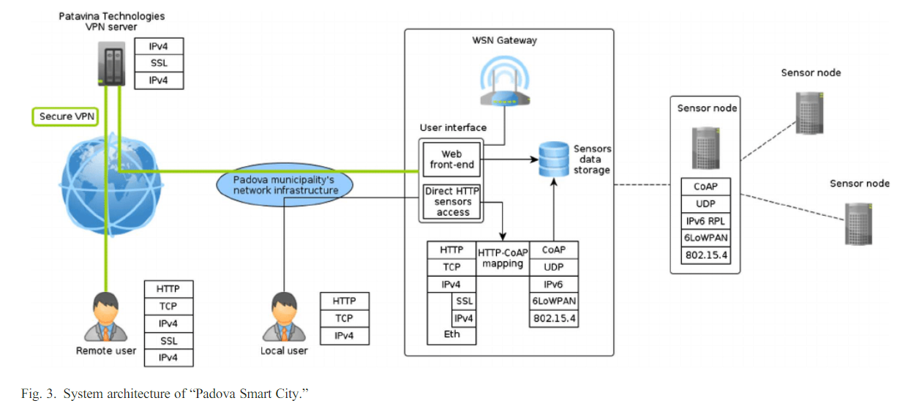
9
Literature Review
We analyzed the solutions currently available for the implementation of smart aquariums. As we can see in the paper, there is the usage of apps that you can connect to using wifi inside homes to get the info and data gathered by the sensors. But, we mainly focused on extending accessibility from anywhere using socket programming's server-client-based communication.
https://www.researchgate.net/publication/260540297_Internet_of_Things_for_Smart_Cities
It will allow us to establish a server-client relationship to fetch data from the server hosted on the Raspberry Pi using a socket module in Python at a specific IP address and a port. We are also trying to make it more real-time by incorporating the data into a web page or app

Slide 13
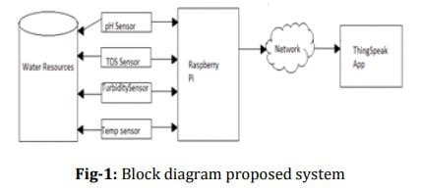
10
Literature Review
Here, the proposed system have measured TDS, Temperature,
Turbidity and pH values of water with the help of Raspberry
Pi and various Sensors to make cost and energy efficient system.
In our system ideal sensor values will differ from this system to accomodate according to the fishes.
https://www.irjet.net/archives/V5/i5/IRJET-V5I5315.pdf
Here they used ThingSpeak API to store and retrieve data
using the HTTP protocol over the Internet.
ThingSpeak enables the creation of sensor logging
applications, location tracking applications, and a social
network of things with status updates.
We will be using python socket programming to get data from microcontroller to our local computer and process it and host on web.

Slide 14




Tasks
We will use sensors
(LDR, water temperature sensor, pH sensor) to collect data.
Then, we will connect them to arduino board and also use ADC (analogue to digital converter) to convert data wherever required.
Further, we will work on establishing communication where Rpi will act as a server and our pc will act as a client over a local ip address on a chosen port

Slide 15


Tasks
Using methods present in socket library in python, will establish the connection between Raspberry pi as server and other pc as client.
Thus, stream type communication (TCP) will be achieved, which will eventually create a web server on a local IP and then our PC will act as a client and ask for data. Rpi (acting as a server) will provide that requested data.
This data will be accessible from any location. We will then work on warning signals when pH or temperature measurements reach close to unfavorable limits.

Slide 16



Tasks
We are planning to use this real time data to display on a web page or something accessible from a remote device (PC or smartphone.)
Finally, we will use data from LDR sensor to toggle light (LED for adjusting brightness in the tank using relays).
If time permits, we will look into the extended features and try incorporating them into our project.

Slide 17


Servo motor based fish feeding system
Fill-and-Drain Water System to regulate temperatue
Displaying data on LCD Display
Extended Additional Features
Control through Android App
Predictions based on data collected
TDS monitoring (Total Dissolved Solids)

Slide 18
Sleep Mode :
Since the deployment duration is expected to run for months or even years, power conservation is imperative. To achieve this, the system design can incorporate sleep mode i.e the system gets a 15 minutes sleep time after an hour of continuous readings. To further extend battery life any idle modules can be set to off mode.
Further to this, alerts can be set to notify the user of certain conditions such as battery life and progress report.
Extended Additional Features

Slide 19
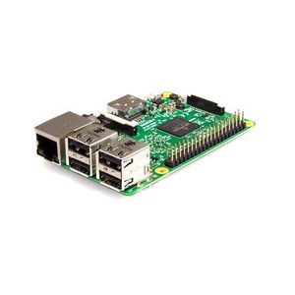
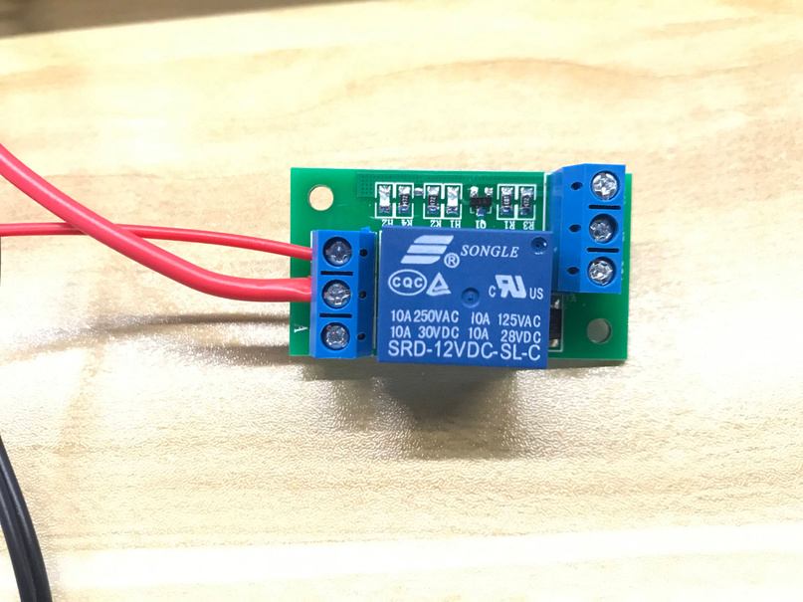
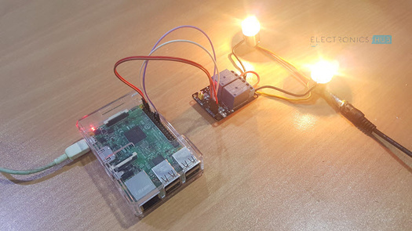
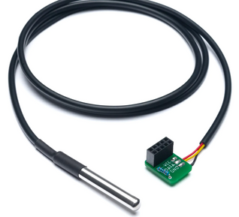
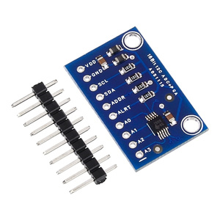
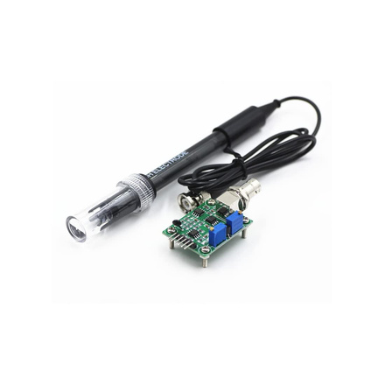

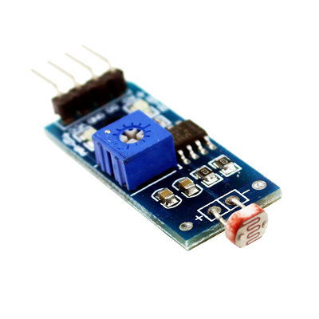
Equipments Required
Raspberry Pi 3
Relay
Light
Water Temperature Sensor
ADS 1115
pH Sensor
Arduino
LDR Sensor

Slide 20
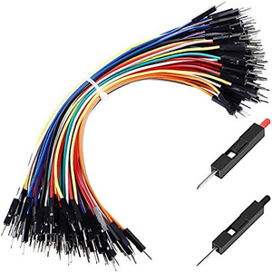
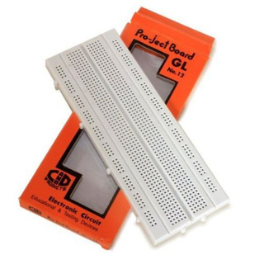
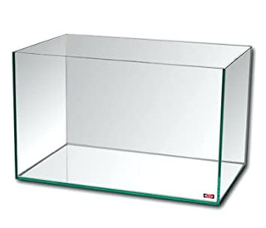
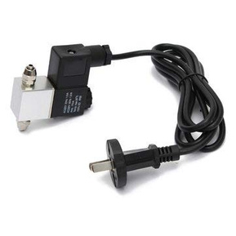
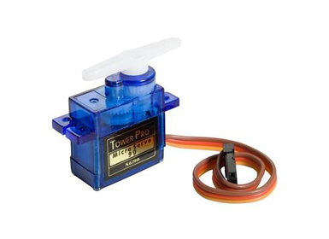
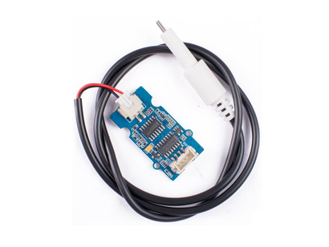
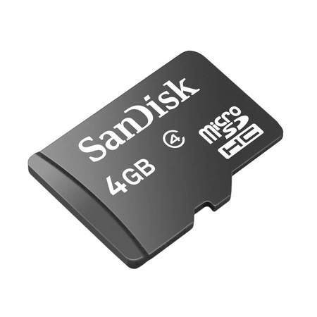
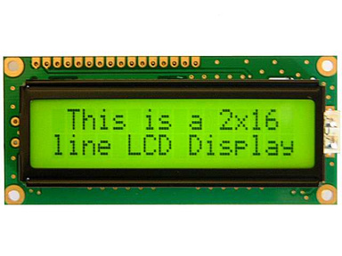
Equipments Required
Wires
Breadboard
Fish Tank
Servo Motor
TDS Sensor
SD card
LCD Display
Solenoid Valve
for extended functionality
for extended functionality
for extended functionality
for extended functionality

Slide 21
Roadmap
Week 0
Week 1
Week 2
Week 3
Week 4
Week 5- end
We will complete all the necessary details and circuitary needed to connect raspberry pi, and its os, arduino, etc.
We will try to get sensors working and will establish connections and will gather all the data in a suitable format.
We will incorporate communication protocol via socket programming using tcp
We will incorporate communication protocol via socket programming using tcp
We will do work on web page/app so that we can access data from a remote device
We will finalize our project. We will bring everything together and work on testing each functionality and try adding extended functionality.

Slide 22
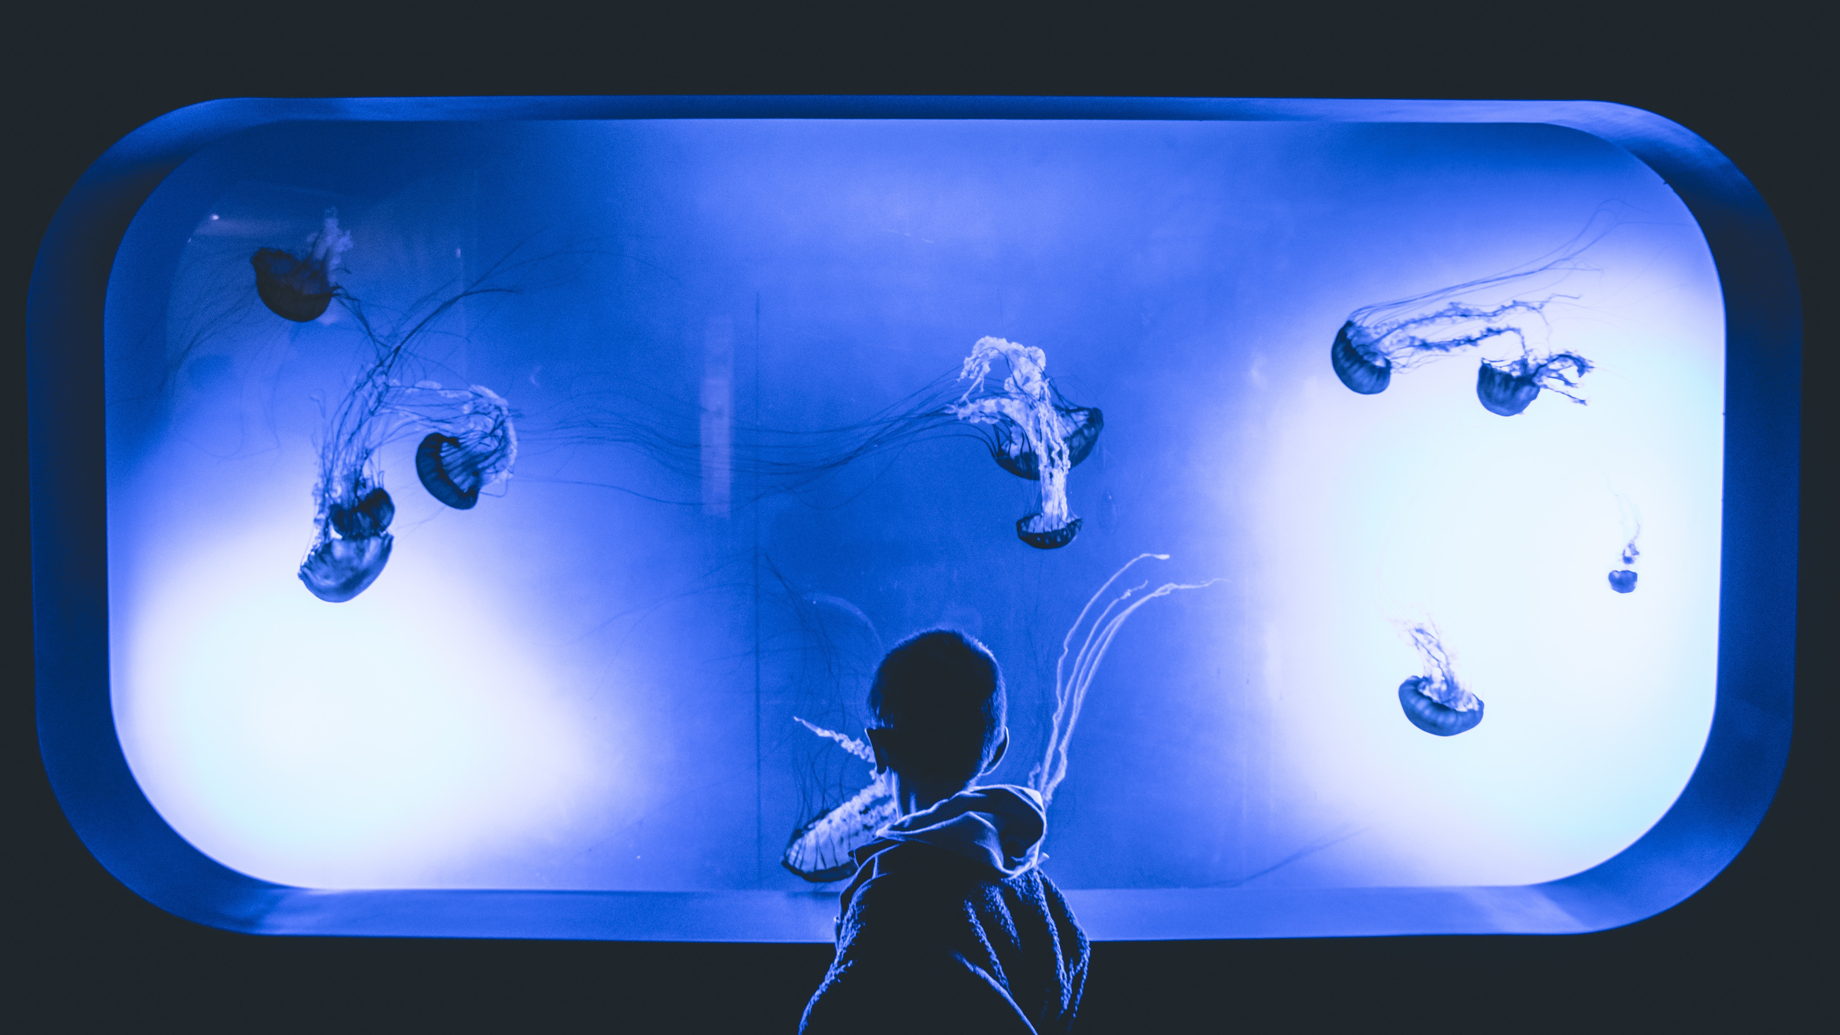
THANK YOU

